Slide 1
Testing Metrics and Tools
Chapter 9

Slide 2
Outline
Testing Metrics
Testing Tools
Interview Questions

Slide 3
What is a Metric?
Metrics can be defined as “STANDARDS OF MEASUREMENT”
Metric is a unit used for describing or measuring an attribute
Test metrics are the means by which the software quality can be measured
Test metrics provides the visibility into the readiness of the product, and gives clear measurement of the quality and completeness of the product

Slide 4
Testing Metrics
"We cannot improve what we cannot measure" and Test Metrics helps us to do exactly the same.
Software Testing Metrics are the quantitative measures used to estimate the progress, quality, productivity and health of the software testing process.
The goal of software testing metrics is to improve the efficiency and effectiveness in the software testing process and to help make better decisions for further testing process by providing reliable data about the testing process.

Slide 5
Testing Metrics
Software testing metrics or software test measurement is the quantitative indication of extent, capacity, dimension, amount or size of some attribute of a process or product.
Example for software test measurement: Total number of defects

Slide 6
Why we need Metrics ?
You cannot improve what you cannot measure
You cannot Control what you cannot measure
Without measurement it is impossible to tell whether the process implemented is improving or not
Metrics helps in taking decisions for next phase of activities
Metrics helps in understanding the type of improvement required and helps in taking decisions on process or technology change

Slide 7
Why Test Metrics are important
Take decision for next phase of activities
Evidence of the claim or prediction
Understand the type of improvement required
Take decision or process or technology change

Slide 8
Why Test Metrics
The aim of collecting test metrics is to use the data for improving the test process. This includes finding answers to the questions like:
How long will it take to test? How much money will it take to test? How bad are the bugs? How many bugs found were fixed? reopened? closed? deferred? How many bugs did the test team did not find? How much of the software was tested? | Will testing be done on time? Can the software be shipped on time? How good were the tests? Are we using low-value test cases? What is the cost of testing? Was the test effort adequate? Could we have fit more testing in this release?

Slide 9
Types of Test Metrics
Testing Metrics
Process Metrics
Product Metrics
Project Metrics
Process Metrics: used to improve the process efficiency of the SDLC ( Software Development Life Cycle)
Product Metrics: deals with the quality of the software product
Project Metrics: used to measure the efficiency of a project team or any testing tools being used by the team members

Slide 10
Identifying Metrics
Identification of correct testing metrics is very important. Few things need to be considered before identifying the test metrics
Fix the target audience for the metric preparation
Define the goal for metrics
Introduce all the relevant metrics based on project needs
Analyze the cost benefits aspect of each metrics and the project lifestyle phase in which it results in the maximum output

Slide 11
Manual Test Metrics
Manual test metrics are classified into two classes
Base Metrics
Calculated Metrics
Manual Test Metrics
Base Metrics
Calculated Metrics

Slide 12
Manual Test Metrics
Base metrics is the raw data collected by Test Analyst during the test case development and execution (# of test cases executed, # of test cases).
Calculated metrics are derived from the data collected in base metrics. Calculated metrics is usually followed by the test manager for test reporting purpose (% Complete, % Test Coverage).

Slide 13
Testing Metrics
Major Base Metrics:
Base Metrics are a great starting point, and can then be used to produce calculated metrics
Total number of test cases Number of test cases passed Number of test cases failed Number of test cases blocked Number of defects found Number of defects accepted | Number of defects rejected Number of defects deferred Number of critical defects Number of planned test hours Number of actual test hours Number of bugs found after shipping

Slide 14
Testing Metrics
Major Calculated Metrics:
Test Coverage Metrics:
Test coverage metrics help answer, “How much of the application was tested?”.
Two major coverage metrics:
Test execution coverage
Requirement coverage

Slide 15

Testing Metrics
Major Calculated Metrics:
Test Coverage Metrics:
1.1
This metric gives us an idea of the total tests executed compared to the total number of tests to be run. It is usually presented as a percentage value

Slide 16

Testing Metrics
Major Calculated Metrics:
Test Coverage Metrics:
1.2
This metric gives us an idea on the percentage of the requirements that have been covered in our testing compared to the total number of requirements

Slide 17

Testing Metrics
Major Calculated Metrics:
Test Effectiveness Metrics: Test effectiveness answers, “How good were the tests?” or “Are we running high value test cases?” It is a measure of the bug-finding ability and quality of a test set. It can be calculated as follow:
2.1
The higher the test effectiveness percentage, the better the test set is and the lesser the test case maintenance effort will be in the long-term.
Example: If for a release the test effectiveness is 80%, it means that 20% of the defects got away from the test team.

Slide 18
Testing Metrics
Major Calculated Metrics:
Test Effort Metrics:
Test effort metrics will answer “how long, how many, and how much” questions about your test effort.
These metrics are great to establish baselines for future test planning.
Major Effort Metrics include:
Number of test runs per time, number of defects per hour, number of bugs per test, and average time to test a bug fix.

Slide 19

Testing Metrics
Major Calculated Metrics:
Test Effort Metrics:
3.1
This metric gives us an idea on the number of test runs over a certain period of time. (i.e. 30 tests per one day)

Slide 20

Testing Metrics
Major Calculated Metrics:
Test Effort Metrics:
3.2
This metric provides information about the rate of finding defects by showing the number of detected defects per test hour.

Slide 21

Testing Metrics
Major Calculated Metrics:
Test Effort Metrics:
3.3
This metric gives an estimation for the number of defects found in one test. This is calculated by dividing the total number of defects over the total number of conducted tests.

Slide 22

Testing Metrics
Major Calculated Metrics:
Test Effort Metrics:
3.4
This metric presents the average time required to test a bug fix.
Example:
Average time to test a defect fix= 4/3 = 1.3 defects per day
Defect | Time between fixing the defect and retesting the fix
D1 | 1 day
D2 | 1 day
D3 | 2 days
Total | 4

Slide 23

Testing Metrics
Major Calculated Metrics:
Test Tracking and Quality Metrics:
4.1
This metric gives an indication on the quality of the tested application. It shows the percentage of passed test cases in relation to the total number of executed tests.

Slide 24

Testing Metrics
Major Calculated Metrics:
Test Tracking and Quality Metrics:
4.2
This gives an indication on the quality of the tested application. It shows the percentage of failed test cases in relation to the total number of executed tests. It also gives an indication on the effectiveness of the conducted tests.

Slide 25

Testing Metrics
Major Calculated Metrics:
Test Tracking and Quality Metrics:
4.3
This metric tracks the percentage of the critical defects in relations to the total number of reported defects.

Slide 26

Testing Metrics
Major Calculated Metrics:
Test Tracking and Quality Metrics:
4.4
This metric calculates the percentage of the fixed defects in relations to the number of the reported defects. This also gives an indication on the efficiency of testing.

Slide 27

Testing Metrics
Major Calculated Metrics:
Test Efficiency Metrics:
5.1
This metric calculates the average time taken to repair a defect by dividing the total time taken to fix all bugs over the total number of bugs. This metric gives an indication on how efficient repairing defects is.

Slide 28
Testing Metrics
Major Calculated Metrics:
More Metrics are used to monitor the testing team productivity, Cost of testing products, etc.
You can read more about testing metrics in:
https://www.qasymphony.com/blog/64-test-metrics/
https://softcrylic.com/blogs/top-25-metrics-measure-continuous-testing-process/
https://www.getzephyr.com/resources/whitepapers/qa-metrics-value-testing-metrics-within-software-development

Slide 29
Cumulative Test Time
The total amount of time spent actually testing the product measured in test hours
Provides an indication of product quality
Is used in computing software reliability growth (the improvement in software reliability that results from correcting faults in the software)

Slide 30
Test Coverage Metrics
Code Coverage (How much of the code is being exercised?)
Segment coverage (percentage of segments hit)
Every (executable) statement is in some segment
A segment corresponds to an edge in a program’s directed graph
Segment coverage is especially useful during unit and integration testing
Segment coverage is cumulative
A goal of 85% is a practical coverage value
Call-pair coverage (percentage of call pairs hit)
An interface whereby one module invokes another
A goal of 100% is a practical coverage value
Requirements coverage (Are all the product’s features being tested?)
The percentage of requirements covered by at least one test

Slide 31
Quality Metrics
Defect removal percentage
What percentage of known defects is fixed at release?
[Number of bugs fixed prior to release/ Number of known bugs prior to release] x 100
Defects reported in each baseline
Can be used to help make decisions regarding process improvements, additional regression testing, and ultimate release of the software
Defect detection efficiency
How well are we performing testing?
[Number of unique defects we find / (Number of unique defects we find + Number of unique defects reported by customers)] x 100
Can be used to help make decisions regarding release of the final product and the degree to which your testing is similar to actual customer use

Slide 32
Summary
Fundamental test metrics are a combination of Base Metrics that can then be used to produce Calculated Metrics.
Base Metrics → raw collected data
Calculated Metrics → calculated from the base metrics

Slide 33
Summary
Major Base Software Test Metrics
Total number of test cases
Number of test cases passed
Number of test cases failed
Number of test cases blocked
Number of defects found
Number of defects accepted
Number of defects rejected
Number of defects deferred
Number of critical defects
Number of planned test hours
Number of actual test hours
Number of bugs found after shipping
Major Calculated Software Test Metrics
Coverage
Test Execution Coverage
Requirement Coverage
Effectiveness
Effort
Number of tests run per time
Number of defects per hour
Number of defects per test
Average time to test a bug fix
Quality
Passed test cases
Failed test cases
Critical test cases
Fixed Defect percentage
Efficiency

Slide 34
Testing Tools

Slide 35
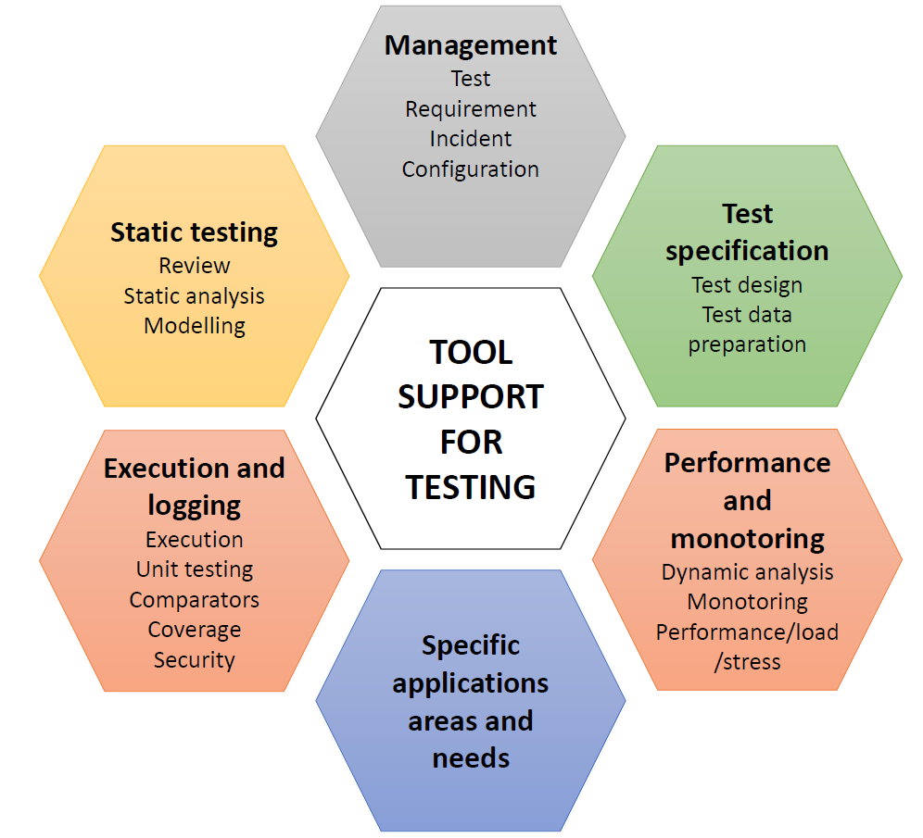

Slide 36
Tool support for testing - types of tools
Test tools can be used for one or more activities that support testing:
Used directly in testing (e.g. test execution tools, test data generation tools, result comparison tools)
Help in managing the testing process (e.g. test results, requirements, incidents, defects) and for monitoring and reporting the test execution
Used in exploration (e.g. tools that monitor the file activity for an application)
Any tool that aids in testing

Slide 37
Tool support for testing - purposes
Tools can have one or more purposes, depending on the context:
improve the efficiency of the test activities (e.g. by automating repetitive tasks)
automate activities that require significant resources when done manually (e.g. static testing)
automate activities that cannot be done manually (e.g. large scale performance testing of client server applications)
increase reliability of testing (by automating large data comparisons or simulating complex behavior)

Slide 38
Test tool classification
Tools are classified according to the testing activities that they support.
one activity
more than one activity, but classification falls under the main activity
Notes
Some types of test tool can be intrusive-the tool itself can affect the outcome of the test. (e.g. timing measurements may be different depending on how you measure it with different performance tools).
The consequence of intrusive tools is called the probe effect.
Some tools offer support more appropriate for developers. Such tools are marked with “(D)”.

Slide 39
Management of testing & tests Tools
Characteristics
Support for the management of tests and the testing activities
Support for traceability of tests , test results and incidents to source documents, such as requirements specifications.
Generation of progress reports
Logging test results (Monitoring)
Offer info on metrics related to the tests.

Slide 40
Management of testing & tests Tools
Test management tools and application lifecycle management tool (ALM)
Requirements management tools
Store requirements
Check for consistency and undefined (missing) requirements
Allow prioritization
Enable individual tests to be traceable to requirements
Defect management tools
Configuration management tools
Necessary to keep track of different versions and builds of SW and tests
Useful when developing on more than one configuration of the HW/SW environment
Continuous integrations tool (D)

Slide 41
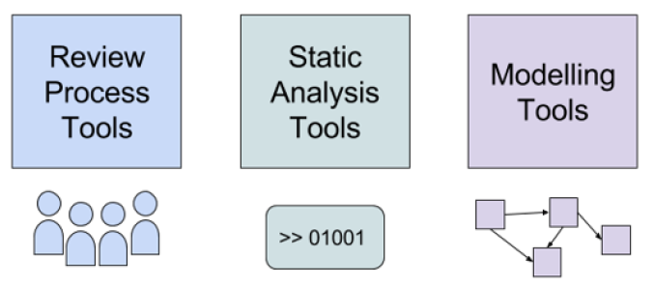
Static Testing Tools
Tools for static testing
Aid in improving the code/work product, without executing it
Categories
Review tools
Supports the review process
Static analysis tools
Supports code examination
Modeling tools
Validate models of system/software

Slide 42
Static Testing Tools
Review process tools
Common reference for the review processes conducted
Keep track of all the information from the review process
Store and communicate review comments, report on defects and effort
Monitoring review status --> Passed, passed with corrections, require re-review
When to use?
Suitable for more formal review processes
Geographically dispersed teams

Slide 43
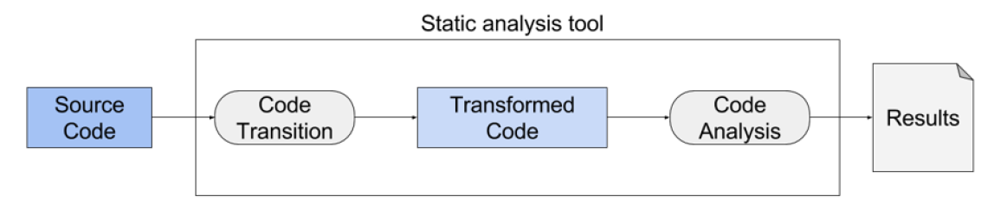
Static Testing Tools
Static analysis tools (D)
Mostly used by developers --> Component (unit) testing
Tool is executed --> Code is not
The source code serves as input data to the tool
Extension of compiler technology

Slide 44
Static Testing Tools
Static analysis tools (D)
Supports developers and testers in finding defects before dynamic testing
Purpose
To better understand the code, and find ways of improving it
Common features
Calculate metrics --> Complexity, nesting levels --> identify areas of risk
Enforce coding standards
Analyze code structures and dependencies

Slide 45
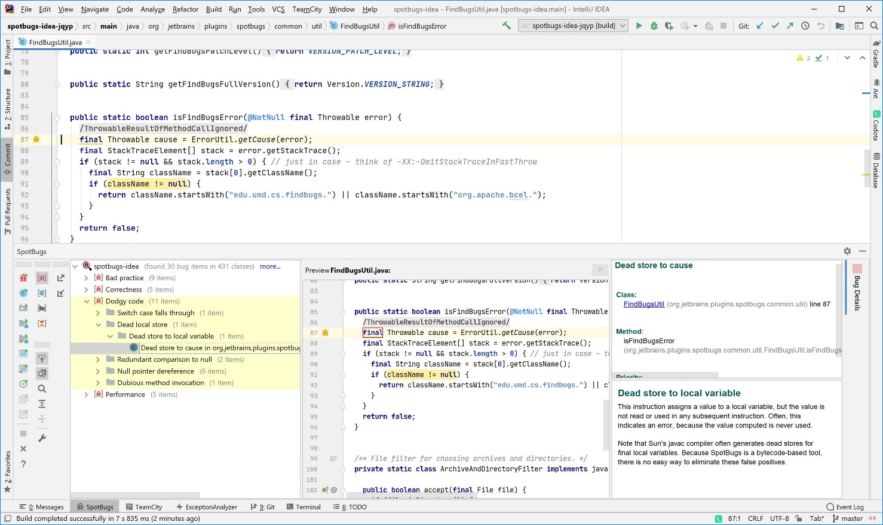
Static analysis tools (D)
SpotBugs
look for bugs in Java code
checks for more than 400 bug patterns

Slide 46
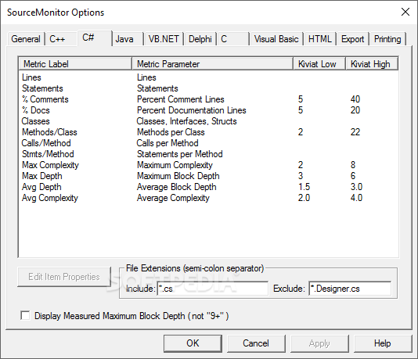
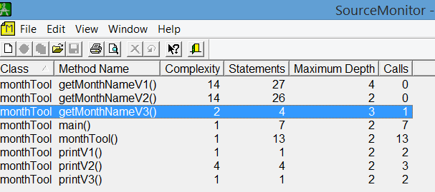
Static analysis tools (D)
Static analysis tool example: Source Monitor
Collects metrics from source code files
Display and prints metrics in tables and charts

Slide 47
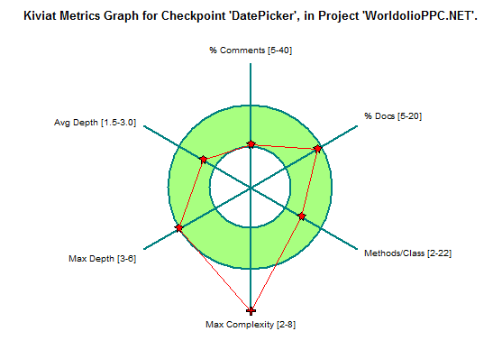
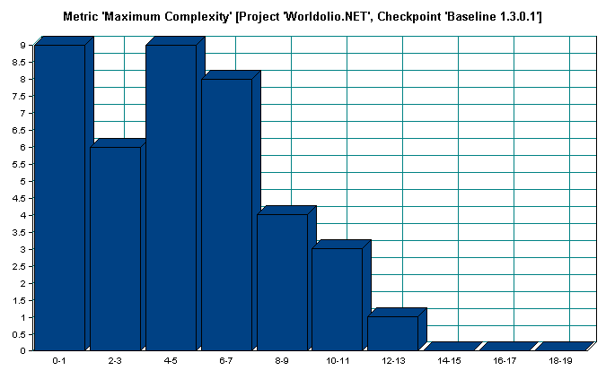
Static analysis tools (D)
Static analysis tool example: Source Monitor

Slide 48
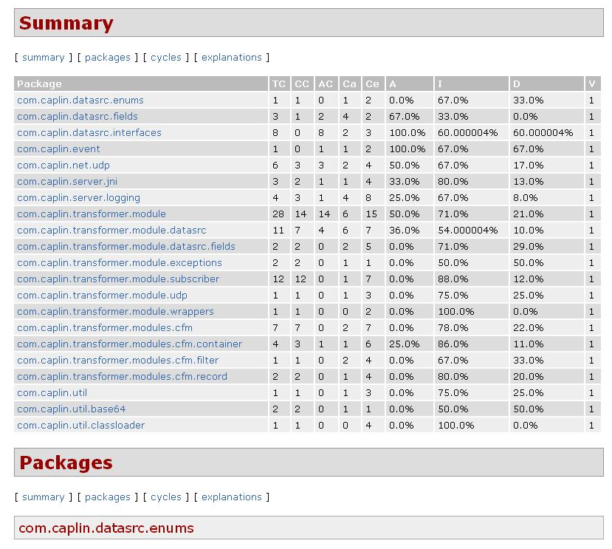
Static analysis tools (D)
JDepend
Generates design quality metrics for each Java package.
Measure the quality of a design in terms of its extensibility, reusability, and maintainability.

Slide 49
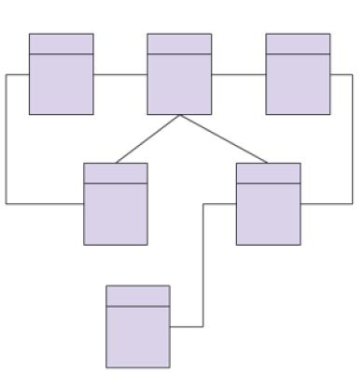
Static Testing Tools
Modeling tools (D)
Validate models of the system/software
Purpose
To better aid in designing the software
Common features and characteristics
Identify inconsistencies and defects within the models
Identify and prioritize risk areas
Predicting system response and behavior under various situations

Slide 50
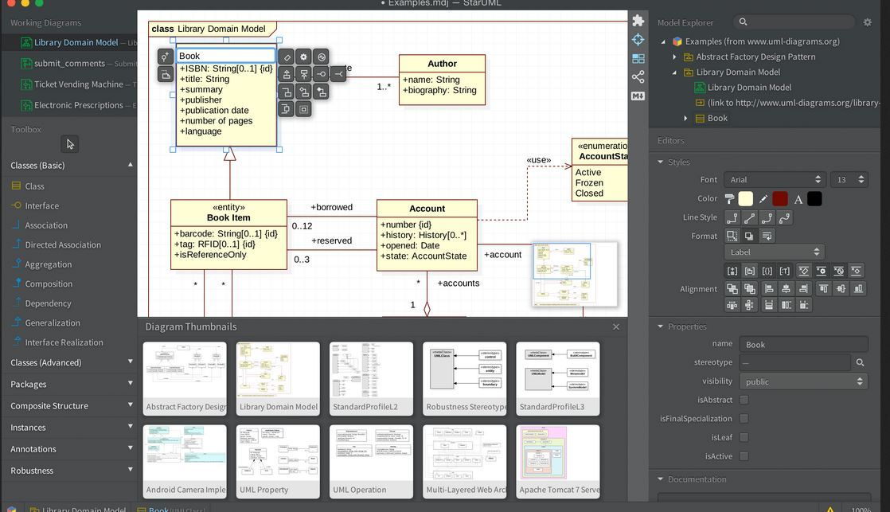
Static Testing Tools
Modeling tool example: StarUML
UML tool
Variety of diagrams
Class/Domain
Use case
Sequence

Slide 51
Static Testing Tools
The major benefit of static testing tools and modeling tools is the cost effectiveness of finding more defects at an earlier time in the development process.
As a result, the development process may accelerate and improve by having less rework.

Slide 52
Test design and specification Tools
Test design tools
Model-based testing tools
Test data preparation tools
TDD -Test driven development tool (D)
ATDD -Acceptance test-driven development and
BDD -Behavior-driven development

Slide 53
Test design and specification Tools
Test design tools
generating test inputs values from:
requirements
test conditions
design models (state, data or object)
code
graphical user interfaces
generating expected results, if an oracle is available to the tool.

Slide 54
Test design and specification Tools
Model-based testing
Generating test inputs values or test cases from stored information the describes a model of the system, e.g. state transition model
Test data preparation tools
Generating extensive range or volume of data, if needed
Manipulate databases or files to set up test data to be used during the execution of the tests

Slide 55
Test design and specification Tools
TDD -Test driven development tool (D)
part of EXtremeProgramming
used in Agile development
ATDD -Acceptance test-driven development and
BDD -Behavior-driven development
Natural language syntax, Given/When/Then:
Given<some condition> , When<something is done>, Then <result should happen>
As a <role, e.g. costumer>
In order to <achieve something, e.g. product>
I want <do something>

Slide 56
Test execution & logging Tools
Test execution tools
Coverage tools
Test harnesses (D) and Unit test framework tools (D)
Test comparators

Slide 57
Test execution & logging Tools
Test execution tools
Enable tests to be executed automatically using stored
Inputs and
expected results
Coverage tools
Identifying coverage items(instrumenting the code)
calculating the percentage of coverage items that were exercised by a suite of tests
reporting coverage items that have not been exercised as yet
identifying test inputs to exercise as yet uncovered items
generating stubs and drivers (if part of a unit test framework).

Slide 58
Test execution & logging Tools
Test harnesses (D) and Unit test framework tools (D)
supplying inputs to the software being tested
receiving outputs generated by the software being tested
executing a set of tests within the framework or using the test harness
recording the pass/fail results of each test (framework tools)
storing tests (framework tools)
support for debugging (framework tools)
coverage measurement at code level (framework tools)

Slide 59
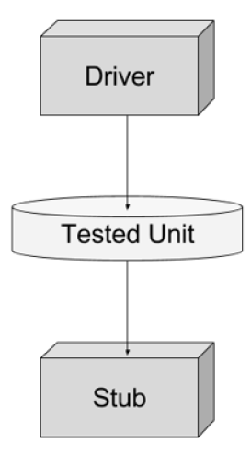
Test execution & logging Tools
Drivers
Calls the component to be tested
In other words: A component that calls the Tested Unit
Stubs
Called from the software component to be tested
In other words: A component the Tested Unit depends on
Partial implementation
Fake values

Slide 60
Test execution & logging Tools
Test harnesses (D) and Unit test framework tools (D)
The two types are similar
Support tools for testing individual componenets or software units
Harness: Stubs and drivers --> Small programs that interact with software
Unit test framework tools --> Support for object-oriented software
When are these tools used?
During test execution and logging

Slide 61
Test execution & logging Tools
Characteristics of test harness and unit test framework tools
Supply inputs to the software being tested
Receive outputs generated by the software being tested
Execute a set of tests within the framework
Record pass/fail results of each test
Store tests
Coverage measurement at code level
Provide support for debugging

Slide 62
Test execution & logging Tools
Test comparators
used when the executed test generates a lot of output.
Testing is more than providing inputs
Need to check if software produces the correct result
Compare actual outcomes to expected results
Two ways of comparing results
Dynamic comparison --> Comparison done during test execution
Post-executing comparison --> Comparison performed after test has finished
Software under test is no longer executing

Slide 63

Performance & monitoring Tools
Test data for performance testing
Real data
Test data obtained from users
Load
Large amounts of test data can be produced
Maintenance
Test data from the production environment

Slide 64
Performance & monitoring Tools
Tests should reflect realistic (correct) scenarios
Systems are often required to handle significant load/interactions
Inadequate/insufficient testing compromises system quality
Setting up test data --> Significant effort
Extensive range or volume of data needed
Creating this data can be very resource-consuming
Test data preparation tools help us manage this effort

Slide 65
Performance & monitoring Tools
Common features of test data preparation tools
Data can be selected from an existing database
Data can be created, generated, and altered for use in tests
Construct a large number of similar records --> Volume tests
When to use?
During test specification and control --> Test data management is difficult
Ensure the system under test is being tested realistically
Useful for performance and reliability testing

Slide 66
Monitoring tools
Monitoring tools identifying problems and sending an alert message to the administrator (e.g. network administrator)
logging real-time and historical information
finding optimal settings
monitoring the number of users on a network
monitoring network traffic (either in real time or covering a given length of time of operation with the analysis performed afterwards).

Slide 67
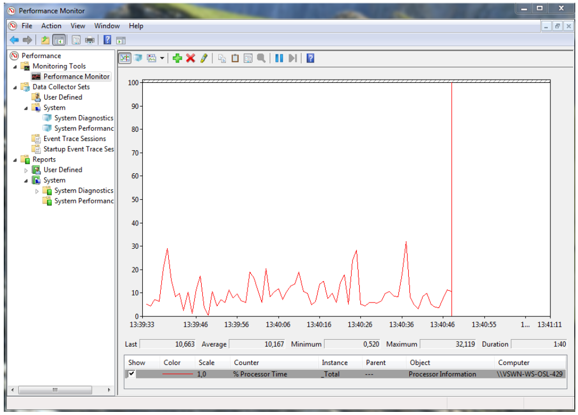
Monitoring tools

Slide 68
Performance & monitoring Tools
Features or characteristics of dynamic analysis tools include support for
detecting memory leaks;
identifying pointer arithmetic errors such as null pointers;
identifying time dependencies

Slide 69
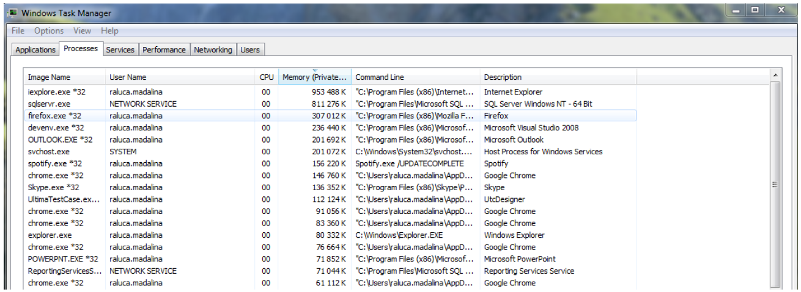
Dynamic analysis tools (D)

Slide 70
Specific application areas Tools
There are tools specialized for use in a particular type of application
Data quality assessment
Data conversion and migration
Usability testing and Accessibility testing
Localization testing
Security testing
Portability testing

Slide 71
Specific application areas Tools
There are tools specialized for use in a particular type of application.
Example:
performance testing tools specifically for web-based applications
dynamic analysis tools specifically for testing security aspects.
Example of targeted areas: embedded systems

Slide 72
Specific application areas Tools
Testers may use:
word processor
spreadsheets
as a testing tool, but they are often used to store
test designs
test scripts
test data.
Testers may also use SQL to set up and query databases containing test data.
Tools used by developers when debugging , to help localize defects and check their fixes, are also testing tools.
It is a good idea to look at any type of tool available to you for ways it could be used to help support any of the testing activities

Slide 73
Effective use of test tools
Simply purchasing or leasing a tool does not guarantee success with that tool!
Each type of tool may require additional effort to achieve real and lasting benefits.

Slide 74
Potential benefits and risks
Reduce repetitive work (running regression tests, re-entring the same test data, etc.)
Greater consistency and repeatability (tests executed by a tool, tests derived from requirements)
Objective assessment (static measures, coverage)
Ease of access to information about tests, or testing (statistics/graphs about test progress, incident rates, performance)

Slide 75
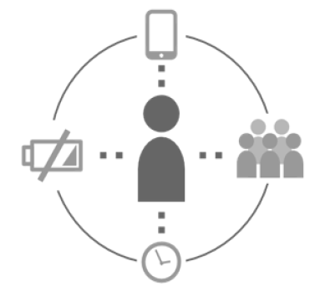
Potential benefits and risks
Greater consistency and repeatability
People tend to do the same tasks in a slightly different way
Distractions affect human performance
Doing more than one task simultaneously
Interruptions by peers / co-workers
Fatigue and personals issues
External pressures
Tools will reproduce the exact same procedure as previously

Slide 76
Potential benefits and risks
Objective assessment
Humans are prone to make errors
Subjective preconceived notions and bias toward verification
Testing tools on the other hand …
Objective “preconceived notions”
Assessment → Repeatable and consistently calculated
Cyclomatic complexity, nesting levels
Coverage, system behavior, incident statistics

Slide 77

Potential benefits and risks
Ease of access to information about the tests or test effort
Information presented visually
Easier for the human mind to understand
Chart, graphs > Long list of numbers
Special purpose tools provide features directly
Statistics and graphs
Incident rates
Performance

Slide 78
Potential risks
Unrealistic expectations for the tool (functionality and ease of use)
Underestimating time, cost, effort for the introduction of a tool (training, external expertise)
Underestimating the time and effort needed to achieve significant and continuing benefits from the tool
Underestimating the effort required to maintain the test assets generated by the tool
Over-reliance on the tool (replacement where manual testing would be better)

Slide 79
Potential benefits and risks
Tools are not magic!
They can do very well what they have been designed to do, but they can not do everything.
The tester concentrates on
What should be tested
What the test cases should be
How to prioritize the testing
The tool user concentrates on
How best to get the tool to do its job effectively
How to give increasing benefit from tool use

Slide 80
Special considerations: Test execution tools
This type of tool often requires significant effort in order to achieve significant benefits.
Capturing tests by recording the actions of a manual tester seems attractive, but this approach does not scale to large numbers of automated tests. This type of script may be unstable when unexpected events occur.
Data-driven approach: separates out the test inputs (the data) and uses a more generic script that can read the test data and perform the same test with different data.
In a keyword-driven approach: the spreadsheet contains keywords with the actions to be taken (also called action words), and test data. Testers can then define tests using the keywords.

Slide 81
Special considerations: Performance testing tools
The design of the load to be generated by the tool
Timing aspects probe effect
How to interpret the information gathered.
These tools need tester with expertise in performance testing to design the tests and interpret results

Slide 82
Special considerations: Static analysis tools
There is a risk that the changes to make old code to conform to new standard will introduce an unexpected side effect
These tools applied to source code can enforce coding standards, but if applied to existing code may generate a lot of messages
A gradual implementation with initial filters to exclude some messages would be an effective approach.

Slide 83
Special considerations: Test management tools
They need to interface with other tools or spreadsheets in order to produce information in the best format for the current needs of the organization.

Slide 84
Introducing a test tool into an organization
The main considerations in selecting a tool for an organization include:
Assess the organizational maturity, strengths and weaknesses
Evaluate against clear requirements and objective criteria
A proof of concept to test the required functionality and determine whether the product meets its objectives
Evaluation of the vendor (including training, support and commercial aspects)
Identification of internal requirements for coaching and mentoring in the use of the tool.

Slide 85
Introducing a test tool into an organization
Introducing the selected tool into an organization starts with a pilot project, with the following objectives
Learn more detail about the tool.
Evaluate how the tool fits with existing processes and practices, and determine what would need to change.
Decide on standard ways of using and maintaining the tool and the test.
Assess whether the benefits will be achieved at reasonable cost

Slide 86
Introducing a test tool into an organization
Success factors for the deployment of the tool within an organization include:
Roll out the tool to the rest of the organization incrementally.
Adapt and improve processes to fit with the use of the tool.
Provide training and coaching/mentoring for new users.
Define usage guidelines.
Implement a way to learn lessons from tool use.
Monitor the tool use and benefits.

Slide 87
Interview Questions and Answers

Slide 88
Fundamental Questions in Testing
When can we stop testing?
Test coverage
What should we test?
Test generation
Is the observed output correct?
Test oracle
How well did we do?
Test efficiency
Who should test your program?
Independent V&V

Slide 89
Interview Questions
What is difference between QA, QC and Software Testing?
What is verification and validation?
Explain Branch Coverage and Decision Coverage.
What is pair-wise programming and why is it relevant to software testing?
Why is testing software using concurrent programming hard? What are races and why do they affect system testing.
Phase in detecting defect: During a software development project two similar requirements defects were detected. One was detected in the requirements phase, and the other during the implementation phase.
Why do we measure defect rates and what can they tell us?
What is Static Analysis?

Slide 90
What is difference between QA, QC and Software Testing?
Quality Assurance (QA): QA refers to the planned and systematic way of monitoring the quality of process which is followed to produce a quality product. QA tracks the outcomes and adjusts the process to meet the expectation. QA is not just testing.
Quality Control (QC): Concern with the quality of the product. QC finds the defects and suggests improvements. The process set by QA is implemented by QC. The QC is the responsibility of the tester.
Software Testing: is the process of ensuring that product which is developed by the developer meets the user requirement. The motive to perform testing is to find the bugs and make sure that they get fixed.

Slide 91
Verification And Validation
What is verification and validation?
Verification: process of evaluating work-products of a development phase to determine whether they meet the specified requirements for that phase.
Validation: process of evaluating software during or at the end of the development process to determine whether it meets specified requirements.

Slide 92
Branch Coverage and Decision Coverage
Explain Branch Coverage and Decision Coverage.
Branch Coverage is testing performed in order to ensure that every branch of the software is executed at least once. To perform the Branch coverage testing we take the help of the Control Flow Graph.
Decision coverage testing ensures that every decision taking statement is executed at least once.
Both decision and branch coverage testing is done to ensure the tester that no branch and decision taking statement will lead to failure of the software.
To Calculate Branch Coverage:
Branch Coverage = Tested Decision Outcomes / Total Decision Outcomes.

Slide 93
What is Static Analysis?
The term "static analysis" is conflated, but here we use it to mean a collection of algorithms and techniques used to analyze source code in order to automatically find bugs.
The idea is similar in spirit to compiler warnings (which can be useful for finding coding errors) but to take that idea a step further and find bugs that are traditionally found using run-time debugging techniques such as testing.
Static analysis bug-finding tools have evolved over the last several decades from basic syntactic checkers to those that find deep bugs by reasoning about the semantics of code.

Slide 94
Defect Costs
Questions:
When you find one, how much will it cost to fix?
How much depends on when the defect was created vs. when you found it?
Just how many do you think are in there to start with?!
Cost
Development Phases
The cost of fixing a defect rises exponentially by lifecycle phase
But this is simplistic
When were the defects injected?
Are all defects treated the same?
Do we reduce costs by getting better at fixing or at prevention?

Slide 95
“QA” & Testing
Testing “Phases”
Unit
Integration
System
User Acceptance Testing
Testing Types
Black-box
White-box
Static vs. Dynamic Testing
Automated Testing
Pros and cons
Integration: 2 types
Top down
Bottom up

Slide 96
Quality Assurance (QA)
Definition - What does Quality Assurance (QA) mean?
Quality assurance (QA) is the process of verifying whether a product meets required specifications and customer expectations. QA is a process-driven approach that facilitates and defines goals regarding product design, development and production. QA's primary goal is tracking and resolving deficiencies prior to product release.
The QA concept was popularized during World War II.

Slide 97
Software Quality Assurance
Software quality assurance (SQA) is a process that ensures that developed software meets and complies with defined or standardized quality specifications.
SQA is an ongoing process within the software development life cycle (SDLC) that routinely checks the developed software to ensure it meets desired quality measures.

Slide 98
Software Quality Assurance
The area of Software Quality Assurance can be broken down into a number of smaller areas such as
Quality of planning,
Formal technical reviews,
Testing
and
Training.

Slide 99
Professional Ethics
If you can’t test it, don’t build it
Put quality first : Even if you lose the argument, you will gain respect
Begin test activities early
Decouple
Designs should be independent of language
Programs should be independent of environment
Couplings are weaknesses in the software!
Don’t take shortcuts
If you lose the argument you will gain respect
Document your objections
Vote with your feet
Don’t be afraid to be right!

Slide 100
Professional Ethics
Recognizing the ACM and IEEE code of ethics for engineers:
PUBLIC - Software testers shall act consistently with the public interest.
CLIENT AND EMPLOYER - Software testers shall act in a manner that is in the best interests of their client and employer, consistent with the public interest.
PRODUCT - Software testers shall ensure that the deliverables they provide (on the products and systems they test) meet the highest professional standards possible.
JUDGMENT - Software testers shall maintain integrity and independence in their professional judgment.
MANAGEMENT - Software test managers and leaders shall subscribe to and promote an ethical approach to the management of software testing.
PROFESSION - Software testers shall advance the integrity and reputation of the profession consistent with the public interest.
COLLEAGUES - Software testers shall be fair to and supportive of their colleagues, and promote cooperation with software developers.
SELF - Software testers shall participate in lifelong learning regarding the practice of their profession and shall promote an ethical approach to the practice of the profession.

